Slide 1
Caribbean restaurants in New York
Matej Kuchar

Slide 2
introduction
Caribbean cuisine is a fusion of African, Creole, Cajun, Amerindian, European, Latin American, Indian/South Asian, Middle Eastern, and Chinese. These traditions were brought from many different countries when they came to the Caribbean. In addition, the population has created styles that are unique to the region. (Source: https://en.wikipedia.org/wiki/Caribbean_cuisine)

Slide 3
Business Goal Description
The client wants to expand his network of caribbean restaurants to New York City and is asking to analyze and recommend a few neighborhoods in NY with low density of caribbean restaurants to open a restaurant in.

Slide 4
data
For information about the venues, Foursquare API, category "Caribbean Restaurant" (ID 4bf58dd8d48988d144941735) will be used. https://developer.foursquare.com/docs/build-with-foursquare/categories/
Dataset which contains the New York borroughs and neighborhoods with their latitudes and longitudes will be used. The dataset can be found in the NYU Spatial Data Repository pages: https://geo.nyu.edu/catalog/nyu_2451_34572

Slide 5
Methodology
Dataset containing New York borroughs and neighboorhoods with their latitudes and longitudes was used and converted into Pandas dataframe. After that using Foursquare API and Folium map, New York neighboorhoods were explored for their density of caribbean restaurants. Finally using k-means clustering the neighborhoods in New York were divided to 5 clusters based on the density of caribbean restaurants.

Slide 6
results
Using K-means clustering, New York neighborhoods were divided to 5 clusters based on density of caribbean restaurants and then displayed on the Folium map. Two clusters had really low number of restaurants. Also, in the beginning of the analysis I found out, that there are around 100 neighboorhoods where there is no caribbean restaurant at all. So, to answer the initial request we could recommend places to open the restaurant in.

Slide 7
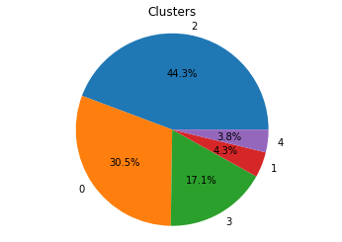
results

Slide 8
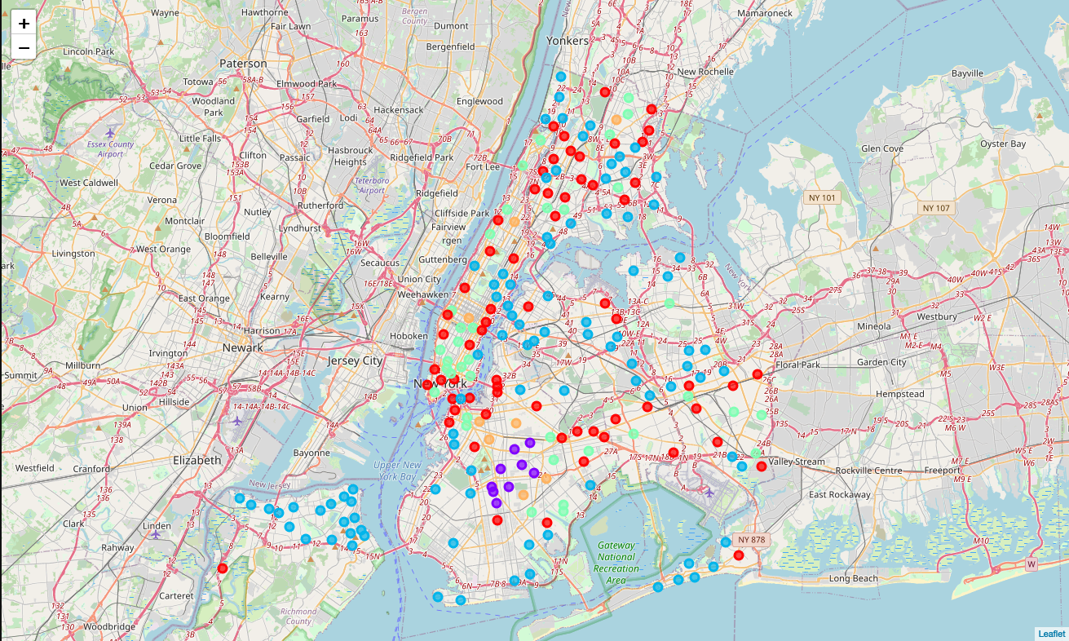
results

